Slide 1
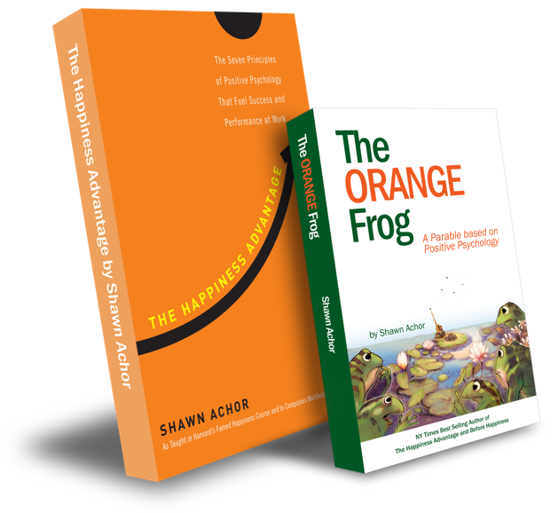
The Happiness Advantage
and
The Orange Frog
By Shawn Achor

Slide 2
Week One

Slide 3
The Fun Fifteen!
Learning Objective:
I can identify what The Fun 15 is
I will discuss the importance of moving my body for at least 15 minutes a day.
Notes:
Standard:
Essential Concept and/or Skill: Communicate and work productively with others emphasizing collaboration and cultural awareness to produce quality work.
Interact positively as a team member.
Cooperate with others in a group setting.
Generate ideas with group members.
Are active listeners.
Read and understand information in a variety of forms.
Express ideas.
Skill:
Active listening, express ideas

Slide 4
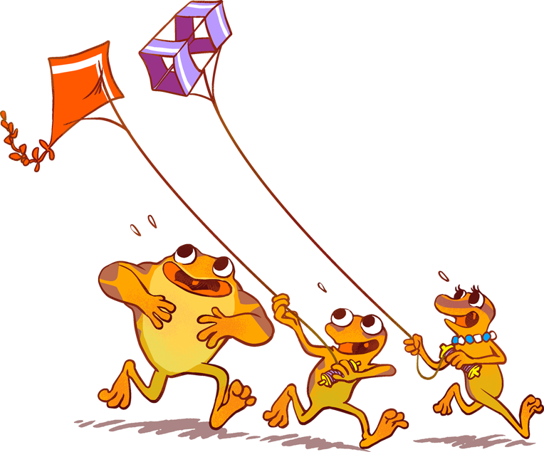
Exercise is physical activity.
It’s the way that people move their bodies to stay active. When someone exercises, they can be healthy and happy. Exercise isn’t just about your actual body. It’s about your brain too.
Your brain can be healthier when you take time to be active. Sometimes, people will say they don’t like to exercise.
That’s why it’s important to make sure and find a kind of exercise that you enjoy

Slide 5
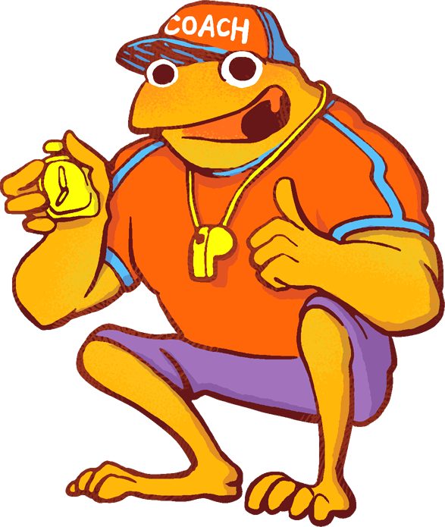
Skills
Self Management
Responsible Decision Making

Slide 6
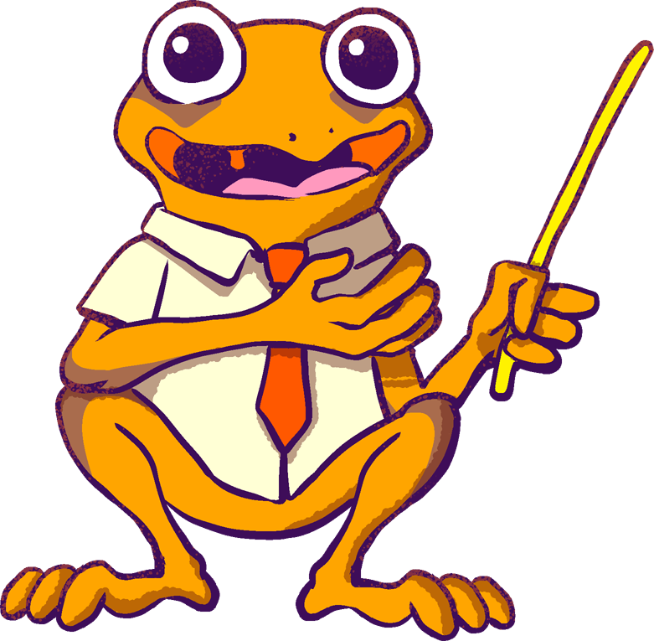
Activity
Today, we are going to have a real conversation about exercise. It seems like you are either for it or not.
There are the athletes that eat sleep and breathe exercise, those who only do it because they have to, and those who hate it.
Which category do you fall into? Turn and talk to the person next to you. Discuss where you stand with exercise.

